Slide 1
Debrief 27/03/23

Slide 2



Week 3: Meeting Project Sponsor (Research, Submit Project Proposal)
 | Monday 27 March | Tuesday 28 March | Wednesday 29 March | Thursday 30 March | Friday 31 March
10.00am to 12.30pm | Corporate Project Meeting Project Sponsors 1 | Corporate Project Project Proposal Preparation | Corporate Project Domain Crash Course: Workshop on Sustainability | Corporate Project | Digital Skills Learning
12.30pm to 2pm | Lunch Break | Lunch Break | Lunch Break | Lunch Break | Lunch Break
2pm to 4.30pm | Corporate Project Project Proposal Preparation | Corporate Project Project Proposal Preparation | Corporate Project Domain Crash Course: Workshop on Digital Marketing | Corporate Project | Digital Skills Learning
Project Proposal Submission to TomoWork
Project Proposal Submission to Sponsor
In-person session at
Republic Polytechnic
Work From Home (WFH)
Flexible arrangement
Company Visit

Slide 3
Programme for 28th March 2023 (Monday)
Time | Event | Venue
9.50am | Report to Republic Poly | E1 6T
10am | Corporate Project Project Proposal Preparation | E1 6T – Kinjo rubber LIBN1 – MSD LIBN2 – foodpanda LIBN3 – EVCO LIBN4 - Micron
12.30pm – 2pm | Lunch
2pm – 4pm | Corporate Project – Work on Project Proposal | E1 6T – Kinjo rubber LIBN1 – MSD LIBN2 – foodpanda LIBN3 – EVCO LIBN4 - Micron
4.15pm – 4.30pm | Debrief | E16T
Things to Bring: Laptop with Charger, money for lunch, writing materials and handphone
Wear: Smart Casual

Slide 4
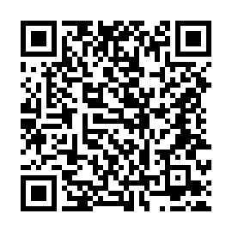
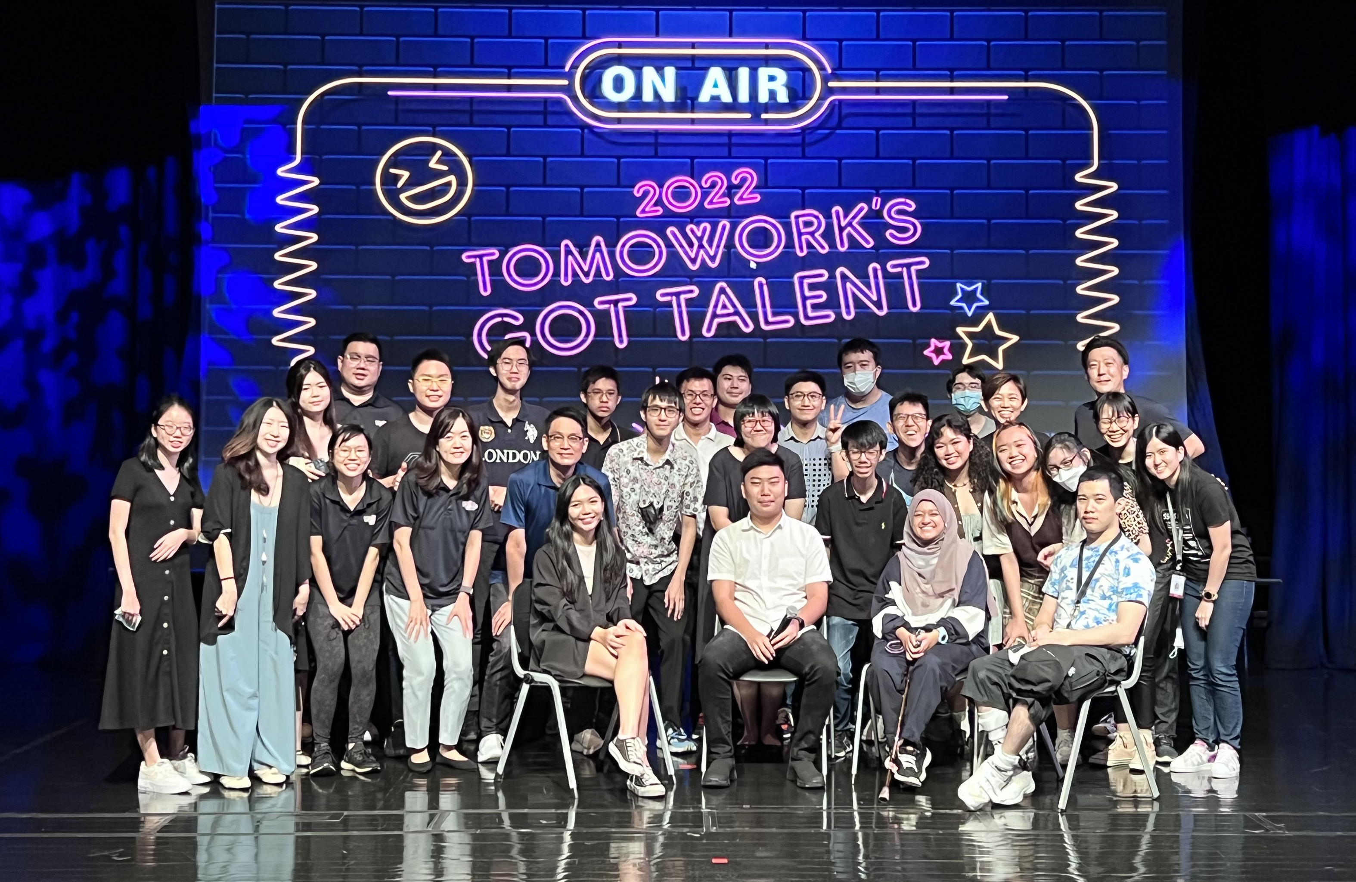
TomoWork’s Got Talent Submission (By Today)
https://tomowork.typeform.com/to/rIKEkJOm

